Slide 1


Deep Learning Techniques for Breast Cancer Prediction Using IBM Cloud

Slide 2

Team Members
Yannam Sri Harshitha (18UK1A05M7)
Thouti Reddy Sudeepa (18UK1A05M4)
Poshala Sai Deepak (18UK1A05L6)
Vuppula Divya (18UK1A05J0)

Slide 3
Table of Contents
Problem Statement
Introduction
Procedure
Solution
Output
Summary

Slide 4

Problem Statement
Breast cancer is one of the main causes of cancer death worldwide. Computer-aided diagnosis systems showed the potential for improving diagnostic accuracy. But early detection and prevention can significantly reduce the chances of death. It is important to detect breast cancer as early as possible. The goal is to classify images into two classifications of “Malignant” and “benign”. As early diagnostics significantly increases the chances of correct treatment and survival. In this application, we are helping the doctors and patients to classify the Type of tumor for the specific image given with the help of Neural Networks.

Slide 5
Introduction
Breast Cancer is a type of cancer that starts in the breast. Breast cancer occurs almost entirely in women, but men can get breast cancer, too. Breast cancer cells usually form a tumor that can often be seen on an x-ray or felt as a lump. Non-Cancerous breast tumors are abnormal growths, but they do not spread outside of the breast. They are not life threating, but some types of benign breast lumps can increase a woman’s risk of getting breast cancer. Any breast lump or change needs to be checked by a health care professional to determine if it is benign or malignant(cancer) and if it might affect your future cancer risk. For this type of future risk prediction we use this kind of Breast Cancer Prediction using Histopathological Images with Deep Learning Techniques.

Slide 6
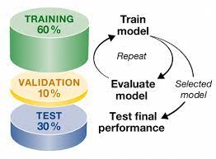




Procedure
Collect the dataset (Histopathology Images)
Build the model by Training and Testing using CNN
Integrate the model built with flask in python file
Create the HTML and CSS for developing the webpage.
Display the output by selecting the Histopathology Image & predicting it.

Slide 7

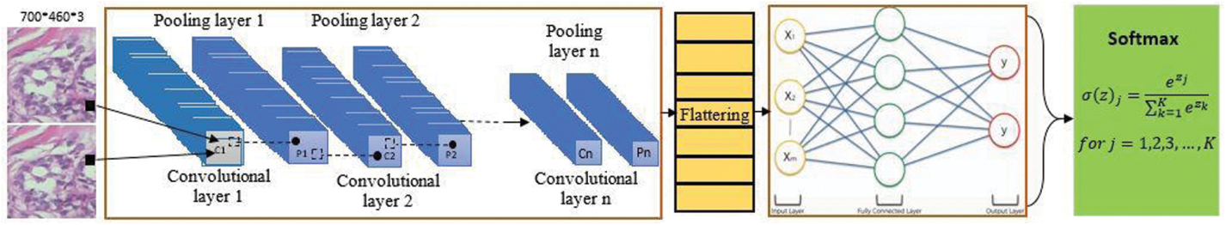
Solution
Breast cancer starts when cells in the breast begin to grow out of control. These cells usually form a tumor that can often be seen on an x-ray or felt as a lump. The tumor is malignant (cancer) if the cells can grow into (invade) surrounding tissues or spread (metastasize) to distant areas of the body. A convolution neural network (CNN) method is proposed in this study to boost the automatic identification of breast cancer by analyzing the Histopathological images. CNNs are applied to explore patterns in an image. CNNs are very effective at detecting objects in images. The proposed system uses CNNs to detect breast cancer from breast tissue images. The architecture of a CNN has 3 main layers, the convolutional layer, pooling layer, and fully connected layer. The first layer calculates the output of neurons which are linked with local regions. Each one is calculated by a dot product of weights and the region. For image inputs, typical filters are small in area such as 3 × 3. Pooling layer uses multiple filters to detect specific patterns which are in common. Pooling layer reduces number of parameters and dimensionality. Flatten layer is the process of converting all resultant 2 dimensional arrays from pooled featured map to a single long continuous linear vector. Further this flattened matrix from flatten layer is fed as input to fully connected layer to classify the image. After Classifying the image the further prediction is done in webpage by uploading an histopathology image which is trained previously in Convolutional Neural Network.

Slide 8

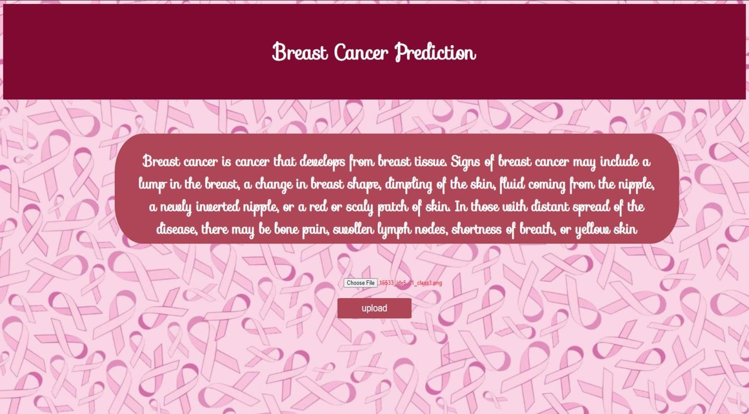
OUTPUT

Slide 9
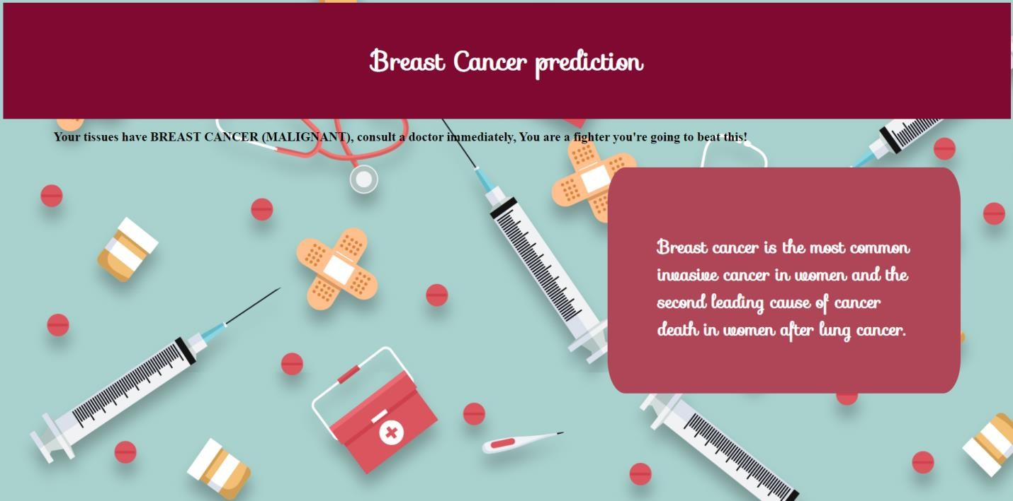
MALIGNANT PREDICTION

Slide 10
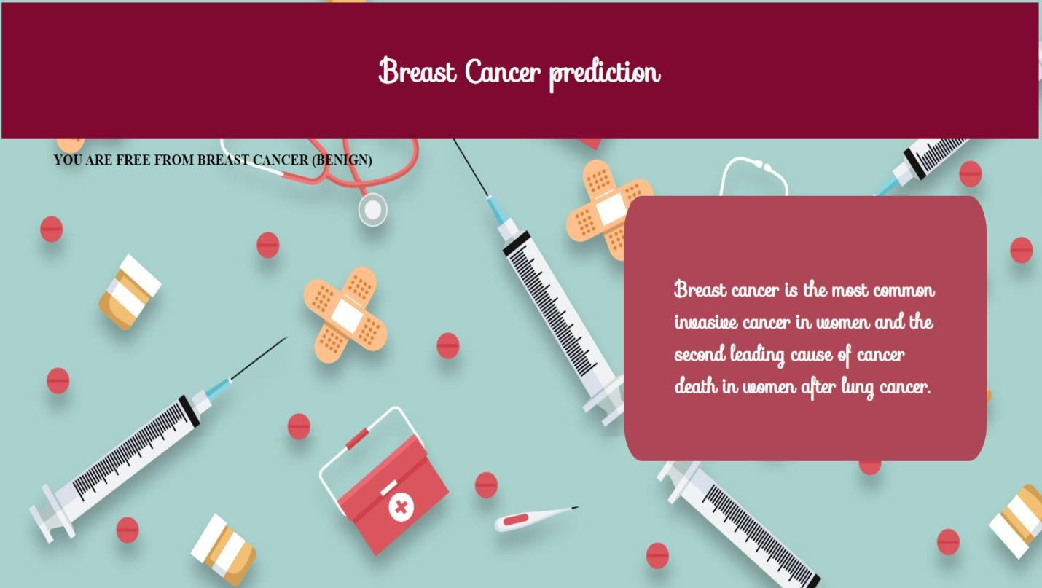
BENIGN PREDICTION

Slide 11
Summary
Our Problem statement is to predict the risk of Breast Cancer using Deep Learning Techniques. First we have collected the histopathological images of breast cancer of type benign and malignant. Next we have trained and tested the images using Convolutional Neural Network which made to classify the type of Breast Cancer i.e., Malignant and Benign. Further by using Flask the python model is deployed and the prediction of Cancer is further rendered with html pages to display the type of breast cancer in a webpage.

Slide 12
Thank You

